Slide 1
Trends and variability in the atmospheric oxidative capacity

Slide 2
Outline
Introduction on OH chemistry
Difficulties and general approaches in deriving OH
Motivation for global box model approach
How does it work (conceptually)
Results
Implications
Discussion (uncertainties, future work)

Slide 3
The role of OH
“The cleansing agent of the atmosphere”
Cracks CH₄, NO, CO and more
Notes:
Very general introduction

Slide 4
OH formation
Notes:
Formation pathways

Slide 5
OH destruction
Notes:
Removal pathways

Slide 6
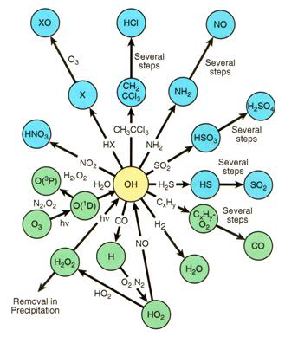
The rest
Notes:
The rest: Very, very much. A lot of it is cycling between H, OH, HO2. Not really important to know it all, but basically it’s very complex

Slide 7
Research objective
same

Slide 8

The tracer approach
Lifetime of seconds, so derived indirectly from a tracer X
$\frac{d\left[X\right]}{dt}=E_{x}−L_{OH}−L_{other}$
Notes:
Complex chemistry , short lifetime: Interactive chemistry is not really feasible.

Slide 9
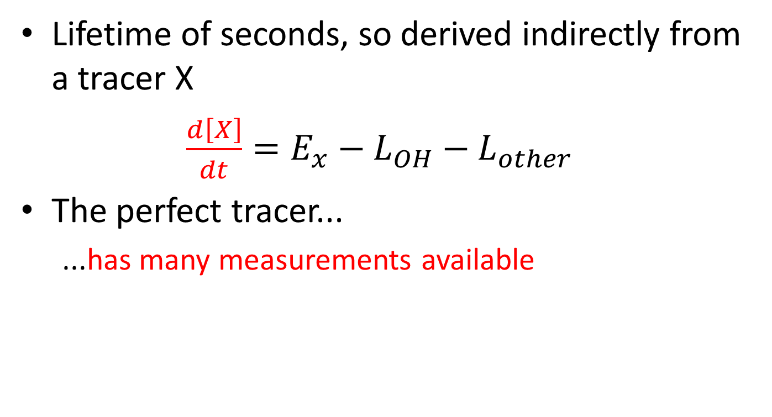
The tracer approach
Lifetime of seconds, so derived indirectly from a tracer X
$\frac{d\left[X\right]}{dt}=E_{x}−L_{OH}−L_{other}$
The perfect tracer...
...has many measurements available
Notes:
Good spatial and temporal coverage

Slide 10
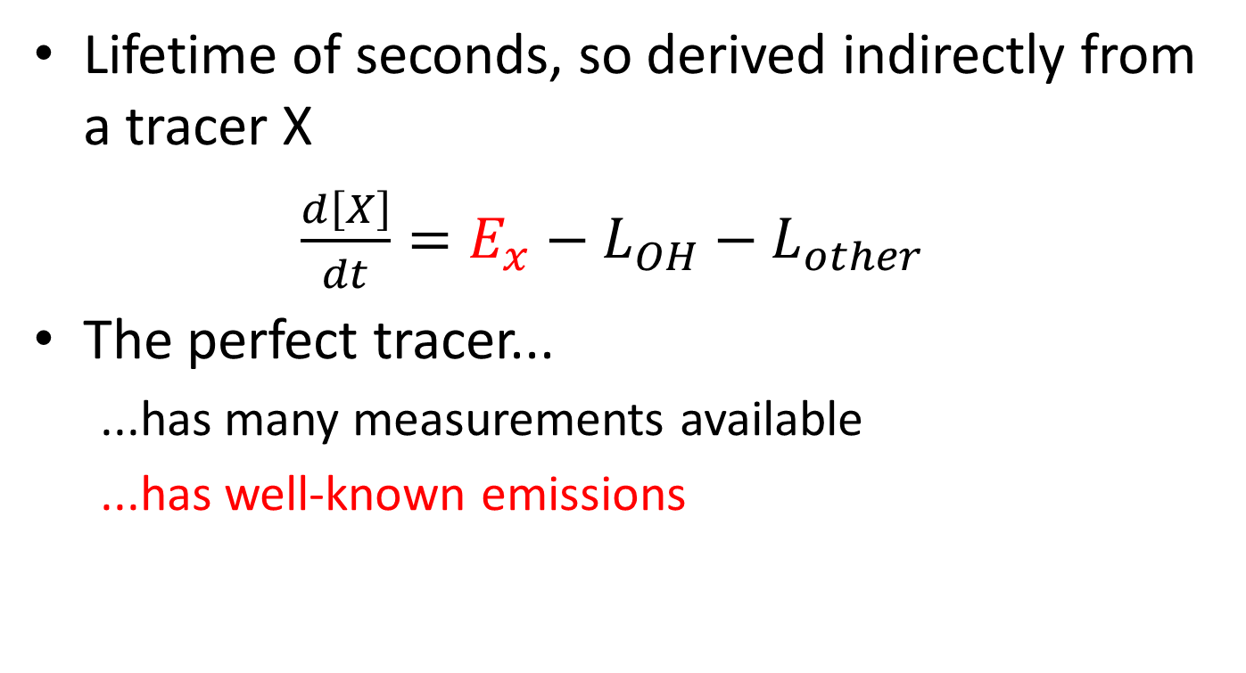
The tracer approach
Lifetime of seconds, so derived indirectly from a tracer X
$\frac{d\left[X\right]}{dt}=E_{x}−L_{OH}−L_{other}$
The perfect tracer...
...has many measurements available
...has well-known emissions
Notes:
Good emission information available. This is probably the most difficult requirement.

Slide 11
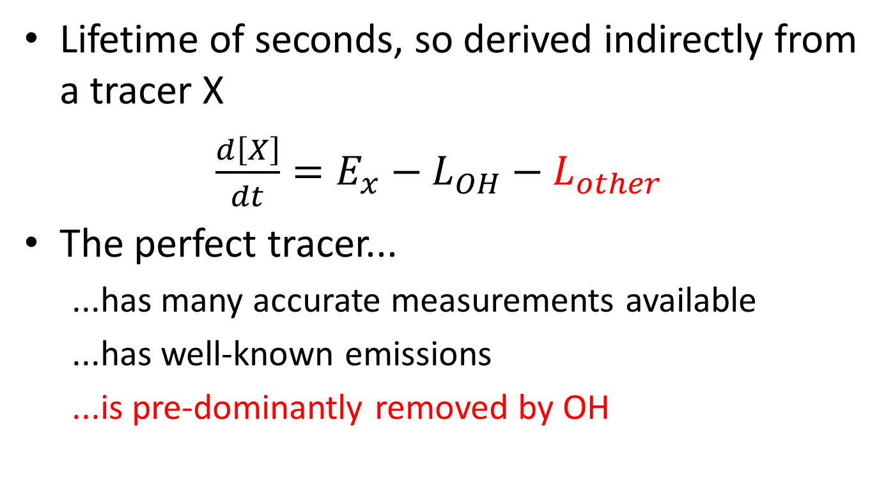
The tracer approach
Lifetime of seconds, so derived indirectly from a tracer X
$\frac{d\left[X\right]}{dt}=E_{x}−L_{OH}−L_{other}$
The perfect tracer...
...has many accurate measurements available
...has well-known emissions
...is pre-dominantly removed by OH
Notes:
Or other has to be well-known too, but will always add uncertainty

Slide 12
Methyl chloroform (CH₃CCl₃)
Only anthropogenic emissions, with well-known production
Two measurement networks (NOAA and (A)GAGE)
Life-time of ~5 years (well-mixed)

Slide 13
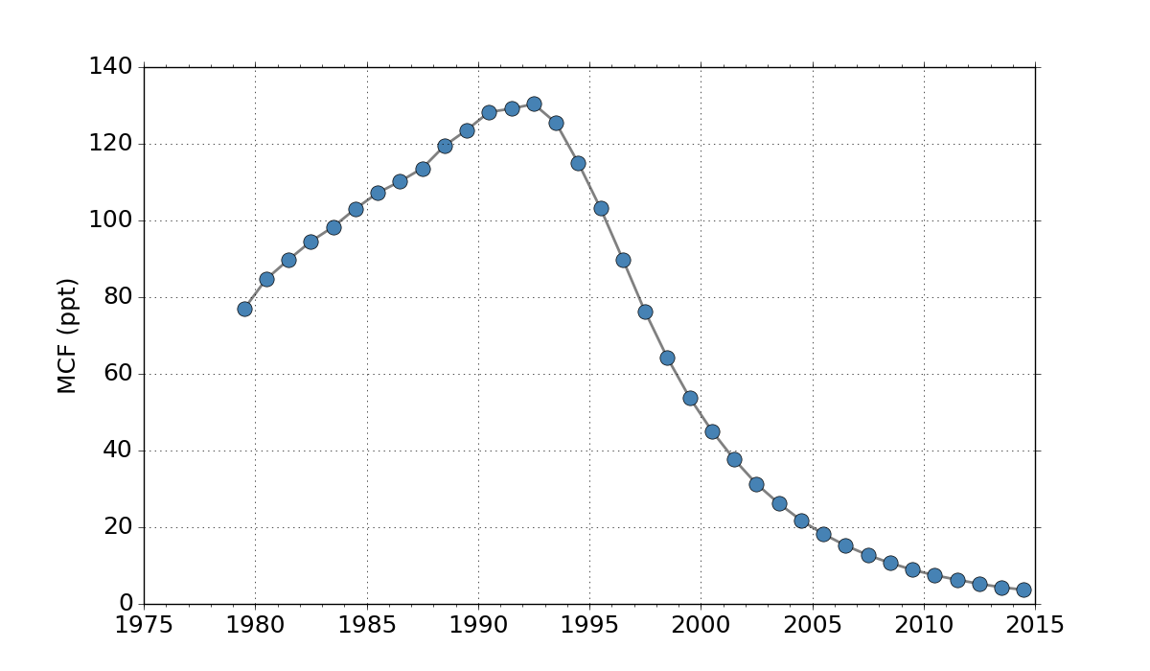
Phase-out in 1993-1997
Methyl chloroform (from (A)GAGE)
A very useful experiment, but ending (or ended)
Notes:
Add in one of my own plots of NOAA MCF.
Also ozone-depleting, so banned in the Montreal protocol. So for a while you have these huge gradients in MCF, only caused by OH (because emissions are low and other sinks are second-order). The global distribution quickly became quite uniform. This all results in a certain period where OH is well-constrained.
But it’s ending .. The measurement errors are actually still quite small, but you have other problems. For one emissions become important again, because though small, gradients are now also small + all emissions that still occur now are undocumented.

Slide 14
Project set-up
A multi-tracer approach using 2 methods:
Global tropospheric box model
Implementation in TM5
Notes:
So basically this is my problem. What does MCF tell us about OH? How does the accuracy of what it is telling us decay? What other tracers are there that can replace MCF?

Slide 15
Inversion approach

Slide 16
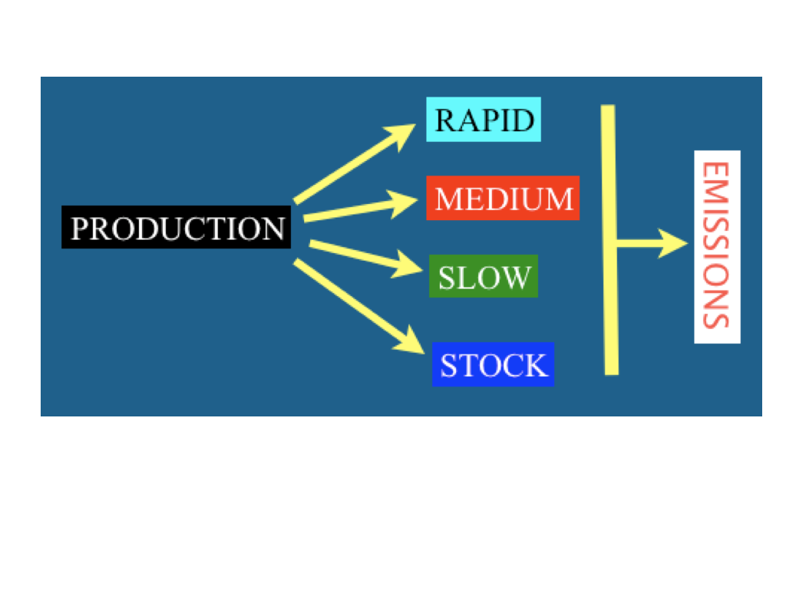
Delayed emissions
Notes:
There is one more issue with MCF. I said previously that we know the production well. Point is, we need to know the emissions well too. And different applications have different release rates of MCF, which lead to the design of different emission categories. So in our approach we add the uncertainty where it actually is and we allow the emissions to shift between categories, keeping the overall production constant.

Slide 17
Current global box model includes:
MCF
CH₄
δ¹³C in CH4
From 1992 - 2014
Notes:
What I will present now includes methyl chloroform (naturally), but also methane and methane isotopes.

Slide 18
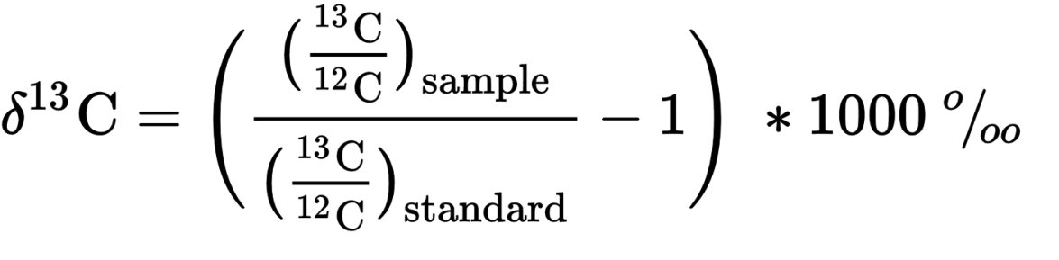
Isotopes
Different number of neutrons, same number of protons
Expressed in relative δ-value:
Notes:
So now I said isotopes, so now I need to explain isotopes.
They are used in atmospheric studies to say something about (changes in) source composition

Slide 19
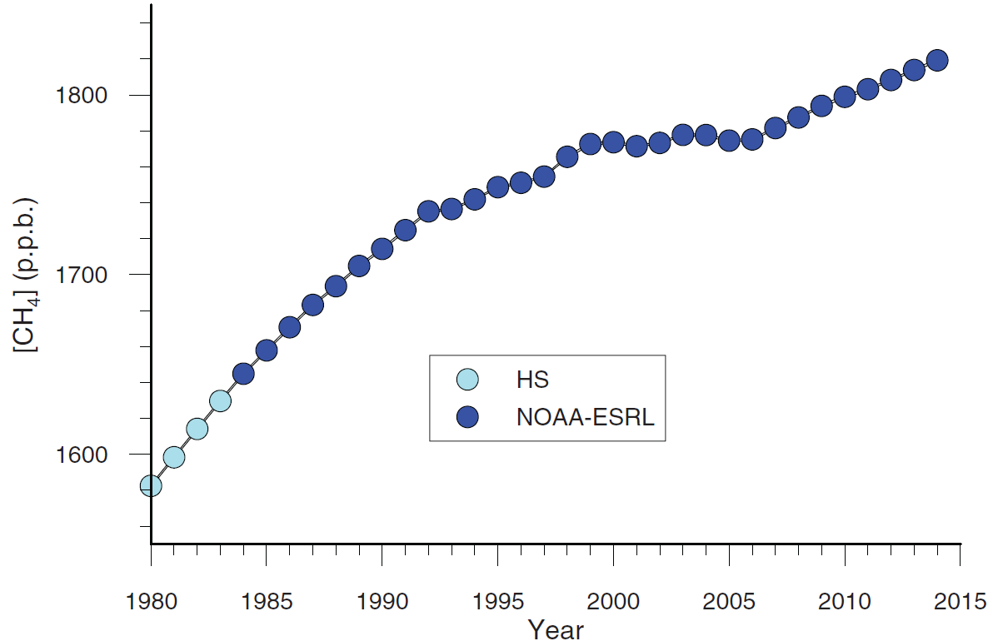
Why CH₄ and δ¹³C?
Schaefer et al. (2016)
Notes:
Methane is where most of the relevance of studying of OH comes from: If I derive OH concentrations the first place to apply it would be to methane anyway.
Additionally, it has the interesting growth rate variations, and a running issue is what the contribution of OH is.

Slide 20
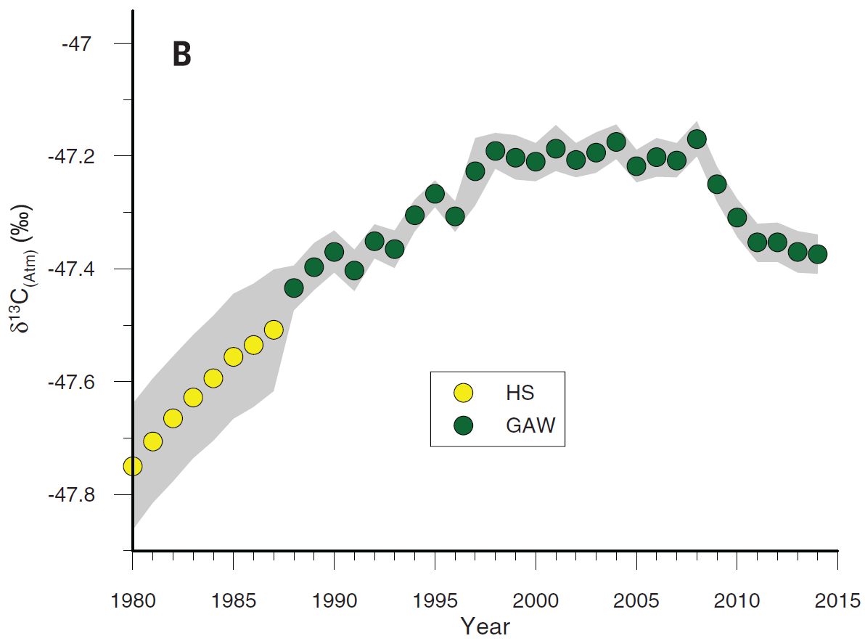
Why CH₄ and δ¹³C?
Schaefer et al. (2016)
Nisbet et al. (2016)
Schwietzke et al. (2016)
Notes:
Now in the past year quite some papers (in not the least journals) were published, combining the two, for reasons that are very clear when you look at the plots: the isotopic composition of the total CH4 source must have changed, so the importance of sources shifted. First indications are that it shifted from fossil fuels to biogenic, but there are many explanations for the signal: the only real conclusion is that something changed. Not the focus of this talk anyway.
However, one side-note in all papers is that the influence of OH is uncertain. And if I include it in the model I can easily answer the question.

Slide 21
Results
Notes:
First, show the normal results, of both NOAA and AGAGE.
Then show what happens when you don’t optimize CH4: ie almost no effect on OH (much freedom in emissions); still kind of a CH4 plateau

Slide 22
MCF emissions
Plot of relative shifts
Plot of absolute changes
Notes:
It is clear that the relative changes in methyl chloroform are quite large. However, this mostly comes from the combination of my method (emission shift) and rapidly decreasing emissions. So, assuming that the way I model this makes sense (and it does), this is actually nicely inherently consistent, due to the nature of my approach.
Also, sum of changes is zero!

Slide 23
OH
Notes:
The OH variations: No rapid interannual variations (note: I did not include a temporal correlation), but some variations on larger timescales. Also, no long-term trend.

Slide 24
OH & Methane
Notes:
And then we can compare this OH to the methane growth rate. The obvious thing is the plateau coinciding with high OH, but the match between the two is a lot higher than a first glance reveals.

Slide 25
Correlation OH vs CH₄ growth rate
Notes:
In a correlation plot the relation is even more clear and better quantified. But maybe this is because of my simple method?

Slide 26
Also when methane is not optimized
Notes:
But it is also found when only MCF is optimized, meaning that MCF gives me OH variations that very well explain the CH4 plateau.
The correlation is higher than that between CH4 emissions and CH4 growth rate, meaning that OH, which is apparently largely prescribed by MCF, better explains short-term CH4 growth rate than short-term CH4 emission variations. The long-term trend is of course set by CH4 emissions.
So perfect result

Slide 27
AGAGE vs NOAA
OH plot
Notes:
The two datasets do show quite different OH. But the correlation remains.

Slide 28
(preliminary) Conclusions
Same

Slide 29
Discussion
Uncertainty in MCF emissions
Correlation CH₄ growth <-> OH
Notes:
Some interesting discussion points that Maarten and I have been talking about.
MCF emissions: Uncertainties (eg no data after 2008 (or earlier even?)) & nature of uncertainties (ie is the emission shift still appropriate in the end)
Correlation: What does it mean exactly? How much of it is OH -> CH4 and how much CH4 -> OH? Is this info somewhere in my model? (I think not) And maybe a bit too in-depth but: How best to quantify the importance of OH for CH4?

Slide 30
Maybe supplementary figures: sensitivities etc.

